Slide 1
SOA Exam FM
Module 2 – Section 5
Unknown Interest Rates Examples

Slide 2


$$Unknown Interest Rates$$
Example: A 10-year annuity immediate with annual payments has an initial payment of $7$. Each subsequent payment is 10% more than its preceding payment. The present value of the annuity is 70.49 using an annual effective interest rate, $i$. Determine $i$.

Slide 3






$$Unknown Interest Rates$$
Example: A 10-year annuity immediate with annual payments has an initial payment of $7$. Each subsequent payment is 10% more than its preceding payment. The present value of the annuity is 70.49 using an annual effective interest rate, $i$. Determine $i$.
$$7$$
$$7(1.1)$$
$$⋯$$
$${7(1.1)}^{9}$$
$$⋯$$
$$years$$
$$PV=70.49$$

Slide 4





$$Unknown Interest Rates$$
$$i=aeir$$
$$7$$
$$7(1.1)$$
$$⋯$$
$${7(1.1)}^{9}$$
$$⋯$$
$$years$$
$$PV=70.49$$

Slide 5
$$Unknown Interest Rates$$
$$i=aeir$$
$$7$$
$$7(1.1)$$
$$⋯$$
$${7(1.1)}^{9}$$
$$⋯$$
$$years$$
$$PV=70.49$$
Step 1: VEP

Slide 6
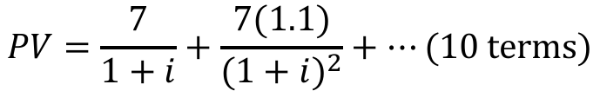
$$Unknown Interest Rates$$
$$i=aeir$$
$$7$$
$$7(1.1)$$
$$⋯$$
$${7(1.1)}^{9}$$
$$⋯$$
$$years$$
$$PV=70.49$$
Step 1: VEP
$$PV=\frac{7}{1+i}+\frac{7(1.1)}{{(1+i)}^{2}}+⋯(10 terms)$$

Slide 7
$$Unknown Interest Rates$$
$$i=aeir$$
$$7$$
$$7(1.1)$$
$$⋯$$
$${7(1.1)}^{9}$$
$$⋯$$
$$years$$
$$PV=70.49$$
Step 1: VEP
$$PV=\frac{7}{1+i}+\frac{7(1.1)}{{(1+i)}^{2}}+⋯(10 terms)$$
Step 2: Factor out the First Term

Slide 8

$$Unknown Interest Rates$$
$$i=aeir$$
$$7$$
$$7(1.1)$$
$$⋯$$
$${7(1.1)}^{9}$$
$$⋯$$
$$years$$
$$PV=70.49$$
Step 1: VEP
$$PV=\frac{7}{1+i}+\frac{7(1.1)}{{(1+i)}^{2}}+⋯(10 terms)$$
Step 2: Factor out the First Term
$$70.49=\frac{7}{1+i}∙\left(1+\frac{1.1}{1+i}+⋯(10 terms)\right)$$

Slide 9

$$Unknown Interest Rates$$
$$i=aeir$$
$$7$$
$$7(1.1)$$
$$⋯$$
$${7(1.1)}^{9}$$
$$⋯$$
$$years$$
$$PV=70.49$$
Step 1: VEP
$$PV=\frac{7}{1+i}+\frac{7(1.1)}{{(1+i)}^{2}}+⋯(10 terms)$$
Step 2: Factor out the First Term
$$70.49=\frac{7}{1+i}∙\left(1+\frac{1.1}{1+i}+⋯(10 terms)\right)$$

Slide 10

$$Unknown Interest Rates$$
$$i=aeir$$
$$7$$
$$7(1.1)$$
$$⋯$$
$${7(1.1)}^{9}$$
$$⋯$$
$$years$$
$$PV=70.49$$
Step 1: VEP
$$PV=\frac{7}{1+i}+\frac{7(1.1)}{{(1+i)}^{2}}+⋯(10 terms)$$
Step 2: Factor out the First Term
$$70.49=\frac{7}{1+i}∙\left(1+\frac{1.1}{1+i}+⋯(10 terms)\right)$$

Slide 11
$$Unknown Interest Rates$$
$$i=aeir$$
$$7$$
$$7(1.1)$$
$$⋯$$
$${7(1.1)}^{9}$$
$$⋯$$
$$years$$
$$PV=70.49$$
Step 1: VEP
$$PV=\frac{7}{1+i}+\frac{7(1.1)}{{(1+i)}^{2}}+⋯(10 terms)$$
Step 2: Factor out the First Term
$$70.49=\frac{7}{1+i}∙\left(1+\frac{1.1}{1+i}+⋯(10 terms)\right)$$

Slide 12
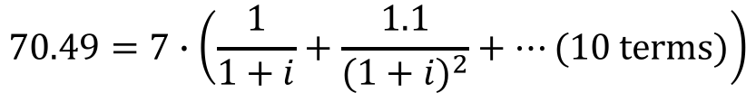
$$Unknown Interest Rates$$
$$i=aeir$$
$$7$$
$$7(1.1)$$
$$⋯$$
$${7(1.1)}^{9}$$
$$⋯$$
$$years$$
$$PV=70.49$$
Step 1: VEP
$$PV=\frac{7}{1+i}+\frac{7(1.1)}{{(1+i)}^{2}}+⋯(10 terms)$$
Step 2: Factor out the First Term
$$70.49=\frac{7}{1+i}∙\left(1+\frac{1.1}{1+i}+⋯(10 terms)\right)$$
$$70.49=7∙\left(\frac{1}{1+i}+\frac{1.1}{{(1+i)}^{2}}+⋯(10 terms)\right)$$

Slide 13
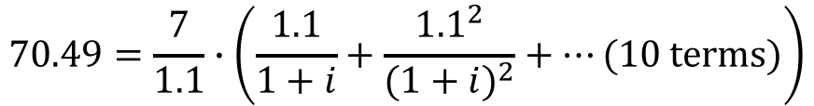
$$Unknown Interest Rates$$
$$i=aeir$$
$$7$$
$$7(1.1)$$
$$⋯$$
$${7(1.1)}^{9}$$
$$⋯$$
$$years$$
$$PV=70.49$$
Step 1: VEP
$$PV=\frac{7}{1+i}+\frac{7(1.1)}{{(1+i)}^{2}}+⋯(10 terms)$$
Step 2: Factor out the First Term
$$70.49=\frac{7}{1+i}∙\left(1+\frac{1.1}{1+i}+⋯(10 terms)\right)$$
$$70.49=\frac{7}{1.1}∙\left(\frac{1.1}{1+i}+\frac{{1.1}^{2}}{{(1+i)}^{2}}+⋯(10 terms)\right)$$

Slide 14
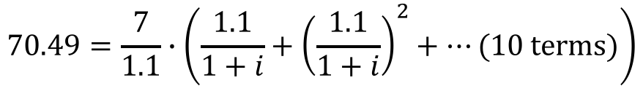
$$Unknown Interest Rates$$
$$i=aeir$$
$$7$$
$$7(1.1)$$
$$⋯$$
$${7(1.1)}^{9}$$
$$⋯$$
$$years$$
$$PV=70.49$$
Step 1: VEP
$$PV=\frac{7}{1+i}+\frac{7(1.1)}{{(1+i)}^{2}}+⋯(10 terms)$$
Step 2: Factor out the First Term
$$70.49=\frac{7}{1+i}∙\left(1+\frac{1.1}{1+i}+⋯(10 terms)\right)$$
$$70.49=\frac{7}{1.1}∙\left(\frac{1.1}{1+i}+{\left(\frac{1.1}{1+i}\right)}^{2}+⋯(10 terms)\right)$$

Slide 15
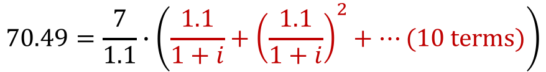
$$Unknown Interest Rates$$
$$i=aeir$$
$$7$$
$$7(1.1)$$
$$⋯$$
$${7(1.1)}^{9}$$
$$⋯$$
$$years$$
$$PV=70.49$$
Step 1: VEP
$$PV=\frac{7}{1+i}+\frac{7(1.1)}{{(1+i)}^{2}}+⋯(10 terms)$$
Step 2: Factor out the First Term
$$70.49=\frac{7}{1+i}∙\left(1+\frac{1.1}{1+i}+⋯(10 terms)\right)$$
$$70.49=\frac{7}{1.1}∙\left(\frac{1.1}{1+i}+{\left(\frac{1.1}{1+i}\right)}^{2}+⋯(10 terms)\right)$$

Slide 16
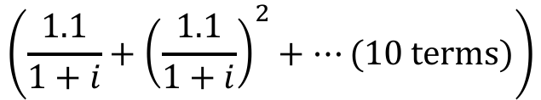
$$Unknown Interest Rates$$
$$\left(\frac{1.1}{1+i}+{\left(\frac{1.1}{1+i}\right)}^{2}+⋯(10 terms)\right)$$

Slide 17
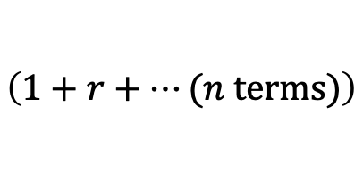
$$Unknown Interest Rates$$
$$\left(\frac{1.1}{1+i}+{\left(\frac{1.1}{1+i}\right)}^{2}+⋯(10 terms)\right)$$
$$\left(1+r+⋯(n terms)\right)$$

Slide 18
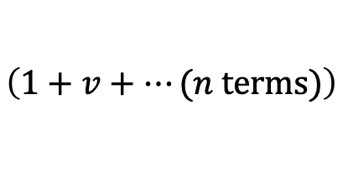
$$Unknown Interest Rates$$
$$\left(\frac{1.1}{1+i}+{\left(\frac{1.1}{1+i}\right)}^{2}+⋯(10 terms)\right)$$
$$\left(1+v+⋯(n terms)\right)$$

Slide 19

$$Unknown Interest Rates$$
$$\left(\frac{1.1}{1+i}+{\left(\frac{1.1}{1+i}\right)}^{2}+⋯(10 terms)\right)$$
$$\left(1+v+⋯(n terms)\right)$$
$$={\ddot{a}}_{\overline{n|}}$$

Slide 20
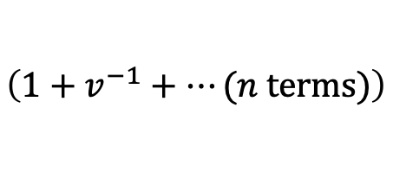
$$Unknown Interest Rates$$
$$\left(\frac{1.1}{1+i}+{\left(\frac{1.1}{1+i}\right)}^{2}+⋯(10 terms)\right)$$
$$\left(1+v^{−1}+⋯(n terms)\right)$$

Slide 21

$$Unknown Interest Rates$$
$$\left(\frac{1.1}{1+i}+{\left(\frac{1.1}{1+i}\right)}^{2}+⋯(10 terms)\right)$$
$$\left(1+v^{−1}+⋯(n terms)\right)$$
$$=s_{\overline{n|}}$$

Slide 22
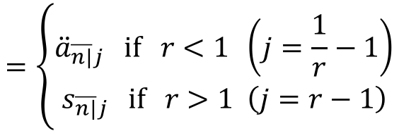
$$Unknown Interest Rates$$
$$\left(\frac{1.1}{1+i}+{\left(\frac{1.1}{1+i}\right)}^{2}+⋯(10 terms)\right)$$
$$=\left\{\begin{aligned}{\ddot{a}}_{\overline{n|}j} if r<1 \left(j=\frac{1}{r}−1\right) \\ s_{\overline{n|}j} if r>1 \left(j=r−1\right)\end{aligned}\right.$$
$$\left(1+r+⋯(n terms)\right)$$

Slide 23
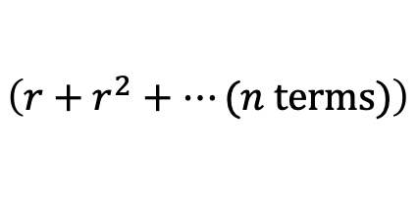
$$Unknown Interest Rates$$
$$\left(\frac{1.1}{1+i}+{\left(\frac{1.1}{1+i}\right)}^{2}+⋯(10 terms)\right)$$
$$=\left\{\begin{aligned}{\ddot{a}}_{\overline{n|}j} if r<1 \left(j=\frac{1}{r}−1\right) \\ s_{\overline{n|}j} if r>1 \left(j=r−1\right)\end{aligned}\right.$$
$$\left(1+r+⋯(n terms)\right)$$
$$\left(r+r^{2}+⋯(n terms)\right)$$

Slide 24
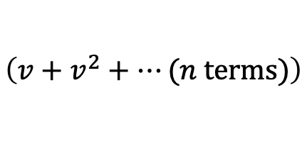
$$Unknown Interest Rates$$
$$\left(\frac{1.1}{1+i}+{\left(\frac{1.1}{1+i}\right)}^{2}+⋯(10 terms)\right)$$
$$=\left\{\begin{aligned}{\ddot{a}}_{\overline{n|}j} if r<1 \left(j=\frac{1}{r}−1\right) \\ s_{\overline{n|}j} if r>1 \left(j=r−1\right)\end{aligned}\right.$$
$$\left(1+r+⋯(n terms)\right)$$
$$\left(v+v^{2}+⋯(n terms)\right)$$

Slide 25

$$Unknown Interest Rates$$
$$\left(\frac{1.1}{1+i}+{\left(\frac{1.1}{1+i}\right)}^{2}+⋯(10 terms)\right)$$
$$=\left\{\begin{aligned}{\ddot{a}}_{\overline{n|}j} if r<1 \left(j=\frac{1}{r}−1\right) \\ s_{\overline{n|}j} if r>1 \left(j=r−1\right)\end{aligned}\right.$$
$$\left(1+r+⋯(n terms)\right)$$
$$\left(v+v^{2}+⋯(n terms)\right)$$
$$=a_{\overline{n|}}$$

Slide 26
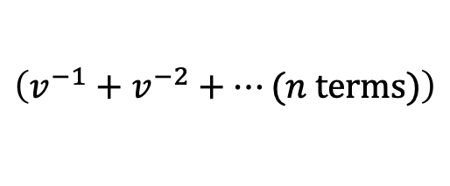
$$Unknown Interest Rates$$
$$\left(\frac{1.1}{1+i}+{\left(\frac{1.1}{1+i}\right)}^{2}+⋯(10 terms)\right)$$
$$=\left\{\begin{aligned}{\ddot{a}}_{\overline{n|}j} if r<1 \left(j=\frac{1}{r}−1\right) \\ s_{\overline{n|}j} if r>1 \left(j=r−1\right)\end{aligned}\right.$$
$$\left(1+r+⋯(n terms)\right)$$
$$\left(v^{−1}+v^{−2}+⋯(n terms)\right)$$

Slide 27

$$Unknown Interest Rates$$
$$\left(\frac{1.1}{1+i}+{\left(\frac{1.1}{1+i}\right)}^{2}+⋯(10 terms)\right)$$
$$=\left\{\begin{aligned}{\ddot{a}}_{\overline{n|}j} if r<1 \left(j=\frac{1}{r}−1\right) \\ s_{\overline{n|}j} if r>1 \left(j=r−1\right)\end{aligned}\right.$$
$$\left(1+r+⋯(n terms)\right)$$
$$\left(v^{−1}+v^{−2}+⋯(n terms)\right)$$
$$={\ddot{s}}_{\overline{n|}}$$

Slide 28
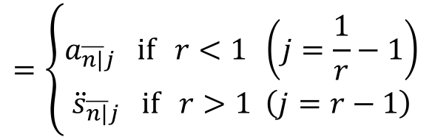
$$Unknown Interest Rates$$
$$\left(\frac{1.1}{1+i}+{\left(\frac{1.1}{1+i}\right)}^{2}+⋯(10 terms)\right)$$
$$=\left\{\begin{aligned}{\ddot{a}}_{\overline{n|}j} if r<1 \left(j=\frac{1}{r}−1\right) \\ s_{\overline{n|}j} if r>1 \left(j=r−1\right)\end{aligned}\right.$$
$$\left(1+r+⋯(n terms)\right)$$
$$=\left\{\begin{aligned}a_{\overline{n|}j} if r<1 \left(j=\frac{1}{r}−1\right) \\ {\ddot{s}}_{\overline{n|}j} if r>1 \left(j=r−1\right)\end{aligned}\right.$$
$$\left(r+r^{2}+⋯(n terms)\right)$$

Slide 29
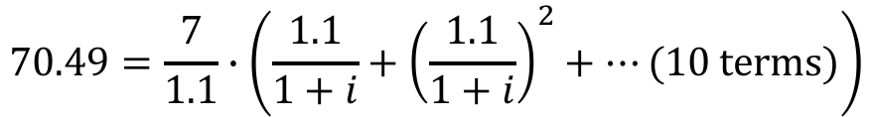
$$Unknown Interest Rates$$
$$i=aeir$$
$$7$$
$$7(1.1)$$
$$⋯$$
$${7(1.1)}^{9}$$
$$⋯$$
$$years$$
$$PV=70.49$$
Step 1: VEP
$$PV=\frac{7}{1+i}+\frac{7(1.1)}{{(1+i)}^{2}}+⋯(10 terms)$$
Step 2: Factor out the First Term
$$70.49=\frac{7}{1.1}∙\left(\frac{1.1}{1+i}+{\left(\frac{1.1}{1+i}\right)}^{2}+⋯(10 terms)\right)$$

Slide 30

$$Unknown Interest Rates$$
$$i=aeir$$
$$7$$
$$7(1.1)$$
$$⋯$$
$${7(1.1)}^{9}$$
$$⋯$$
$$years$$
$$PV=70.49$$
Step 1: VEP
$$PV=\frac{7}{1+i}+\frac{7(1.1)}{{(1+i)}^{2}}+⋯(10 terms)$$
Step 2: Factor out the First Term
$$70.49=\frac{7}{1.1}∙\left(\frac{1.1}{1+i}+{\left(\frac{1.1}{1+i}\right)}^{2}+⋯(10 terms)\right)$$

Slide 31
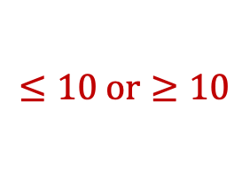
$$Unknown Interest Rates$$
$$i=aeir$$
$$7$$
$$7(1.1)$$
$$⋯$$
$${7(1.1)}^{9}$$
$$⋯$$
$$years$$
$$PV=70.49$$
Step 1: VEP
$$PV=\frac{7}{1+i}+\frac{7(1.1)}{{(1+i)}^{2}}+⋯(10 terms)$$
Step 2: Factor out the First Term
$$70.49=\frac{7}{1.1}∙\left(\frac{1.1}{1+i}+{\left(\frac{1.1}{1+i}\right)}^{2}+⋯(10 terms)\right)$$
$$≤10 or≥10$$

Slide 32
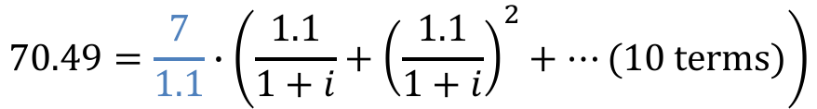
$$Unknown Interest Rates$$
$$i=aeir$$
$$7$$
$$7(1.1)$$
$$⋯$$
$${7(1.1)}^{9}$$
$$⋯$$
$$years$$
$$PV=70.49$$
Step 1: VEP
$$PV=\frac{7}{1+i}+\frac{7(1.1)}{{(1+i)}^{2}}+⋯(10 terms)$$
Step 2: Factor out the First Term
$$70.49=\frac{7}{1.1}∙\left(\frac{1.1}{1+i}+{\left(\frac{1.1}{1+i}\right)}^{2}+⋯(10 terms)\right)$$

Slide 33

$$Unknown Interest Rates$$
$$i=aeir$$
$$7$$
$$7(1.1)$$
$$⋯$$
$${7(1.1)}^{9}$$
$$⋯$$
$$years$$
$$PV=70.49$$
Step 1: VEP
$$PV=\frac{7}{1+i}+\frac{7(1.1)}{{(1+i)}^{2}}+⋯(10 terms)$$
Step 2: Factor out the First Term
$$70.49=\frac{7}{1.1}∙\left(\frac{1.1}{1+i}+{\left(\frac{1.1}{1+i}\right)}^{2}+⋯(10 terms)\right)$$
$$=6.36$$

Slide 34
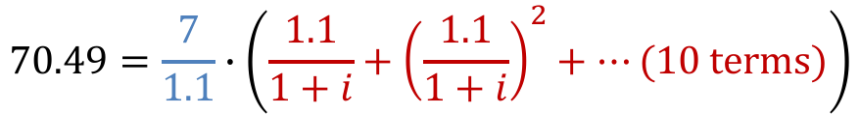

$$Unknown Interest Rates$$
$$i=aeir$$
$$7$$
$$7(1.1)$$
$$⋯$$
$${7(1.1)}^{9}$$
$$⋯$$
$$years$$
$$PV=70.49$$
Step 1: VEP
$$PV=\frac{7}{1+i}+\frac{7(1.1)}{{(1+i)}^{2}}+⋯(10 terms)$$
Step 2: Factor out the First Term
$$70.49=\frac{7}{1.1}∙\left(\frac{1.1}{1+i}+{\left(\frac{1.1}{1+i}\right)}^{2}+⋯(10 terms)\right)$$
$$=6.36$$
$$≥10$$

Slide 35
$$Unknown Interest Rates$$
$$i=aeir$$
$$7$$
$$7(1.1)$$
$$⋯$$
$${7(1.1)}^{9}$$
$$⋯$$
$$years$$
$$PV=70.49$$
Step 1: VEP
$$PV=\frac{7}{1+i}+\frac{7(1.1)}{{(1+i)}^{2}}+⋯(10 terms)$$
Step 2: Factor out the First Term
$$70.49=\frac{7}{1.1}∙\left(\frac{1.1}{1+i}+{\left(\frac{1.1}{1+i}\right)}^{2}+⋯(10 terms)\right)$$
Step 3: Recognize

Slide 36

$$Unknown Interest Rates$$
$$i=aeir$$
$$7$$
$$7(1.1)$$
$$⋯$$
$${7(1.1)}^{9}$$
$$⋯$$
$$years$$
$$PV=70.49$$
Step 1: VEP
$$PV=\frac{7}{1+i}+\frac{7(1.1)}{{(1+i)}^{2}}+⋯(10 terms)$$
Step 2: Factor out the First Term
$$70.49=\frac{7}{1.1}∙\left(\frac{1.1}{1+i}+{\left(\frac{1.1}{1+i}\right)}^{2}+⋯(10 terms)\right)$$
Step 3: Recognize
$$70.49=\frac{7}{1.1}∙{\ddot{s}}_{\overline{10|}j}$$

Slide 37

$$Unknown Interest Rates$$
$$i=aeir$$
$$7$$
$$7(1.1)$$
$$⋯$$
$${7(1.1)}^{9}$$
$$⋯$$
$$years$$
$$PV=70.49$$
Step 1: VEP
$$PV=\frac{7}{1+i}+\frac{7(1.1)}{{(1+i)}^{2}}+⋯(10 terms)$$
Step 2: Factor out the First Term
$$70.49=\frac{7}{1.1}∙\left(\frac{1.1}{1+i}+{\left(\frac{1.1}{1+i}\right)}^{2}+⋯(10 terms)\right)$$
Step 3: Recognize
$$70.49=\frac{7}{1.1}∙{\ddot{s}}_{\overline{10|}j}$$
$$⇒j=0.01851⋯$$

Slide 38

$$Unknown Interest Rates$$
$$i=aeir$$
$$7$$
$$7(1.1)$$
$$⋯$$
$${7(1.1)}^{9}$$
$$⋯$$
$$years$$
$$PV=70.49$$
Step 1: VEP
$$PV=\frac{7}{1+i}+\frac{7(1.1)}{{(1+i)}^{2}}+⋯(10 terms)$$
Step 2: Factor out the First Term
$$70.49=\frac{7}{1.1}∙\left(\frac{1.1}{1+i}+{\left(\frac{1.1}{1+i}\right)}^{2}+⋯(10 terms)\right)$$
Step 3: Recognize
$$70.49=\frac{7}{1.1}∙{\ddot{s}}_{\overline{10|}j}$$
$$=\frac{1.1}{1+i}−1$$
$$⇒j=0.01851⋯$$

Slide 39

$$Unknown Interest Rates$$
$$i=aeir$$
$$7$$
$$7(1.1)$$
$$⋯$$
$${7(1.1)}^{9}$$
$$⋯$$
$$years$$
$$PV=70.49$$
Step 1: VEP
$$PV=\frac{7}{1+i}+\frac{7(1.1)}{{(1+i)}^{2}}+⋯(10 terms)$$
Step 2: Factor out the First Term
$$70.49=\frac{7}{1.1}∙\left(\frac{1.1}{1+i}+{\left(\frac{1.1}{1+i}\right)}^{2}+⋯(10 terms)\right)$$
Step 3: Recognize
$$70.49=\frac{7}{1.1}∙{\ddot{s}}_{\overline{10|}j}$$
$$=\frac{1.1}{1+i}−1$$
$$⇒j=0.01851⋯$$
$$⇒i=0.08$$

